Slide 1
DDNS/P2P Resetting Manual

Slide 2
Contents
1. New DDNS/P2P functions
2. How to reset DDNS/P2P
1-1. Overview of function changes
1-2. Target models
2-1. Check function usage status
2-2. How to reset
2-3. Q&A

Slide 3
1. New DDNS/P2P functions
PARTNER

Slide 4
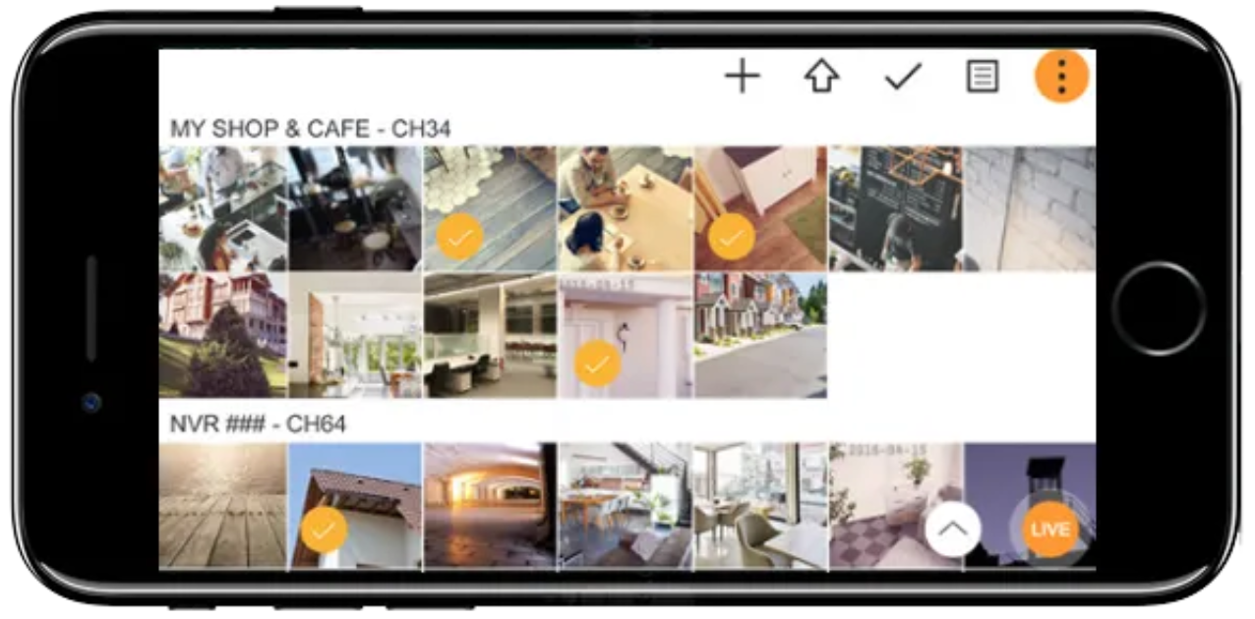
1-1. Overview of function changes
DDNS/P2P functions integrated and connection path improved.
DDNS ID created and automatically registered, and P2P UID (QR) created upon selecting DDNS/P2P functions activation.
Provide by integrating DDNS and P2P individual remote access methods (DDNS, Cloud automatic conversion)
Apply Cloud-based P2P to complement the turn server access delay
Before
After
1
2
Select or
Automatic conversion
DDNS Server
Turn Server
DDNS Server
Cloud
1
DDNS method connection
UID (QR code) method connection
2
1
Connect to DDNS server
If the DDNS server path is unavailable
2
Client
Client
PARTNER

Slide 5
1-2. Target models
Target models for DDNS/P2P changes
The products below need to be checked with the guide details if they are to proceed with the software update to versions higher than indicated.
Category | Model | Target Version
PRN | 6410DB4, 6405DB4, 6400DB4, 6410B4, 6405B4, 6400B4 | V 4.10.10 or lower
 | 3210B4, 3205B4, 3200B4, 3210B2, 3205B2, 3200B2
 | 1610B2, 1605B2, 1600B2
XRN | 6410DB4, 6410B4, 6410RB2, 6410B2
 | 3210B4, 3210RB2, 3210B2, 1620SB1, 1620B2, 820S
 | 420S | V 4.10.00 or lower
QRN | 430S | V 4.10.00 or lower
HRX | 435, 434 | V 4.09.00 or lower
PARTNER

Slide 6
2. How to reset DDNS/P2P
PARTNER

Slide 7
2-1. Check function usage status
Current usage status and measures
Check out the measures to maintain the environment with the same status before the software update.
0
Activate
DDNS/P2P
Check out a new
DDNS ID
Remove NVR from
the app
Re-register NVR
using a new QR
Upgrade
1
2
3
4
5
Case 1
1
2
If only DDNS is used
Case 2
1
2
3
4
5
If only P2P is used
Case 3
1
2
4
5
If both DDNS and P2P are used
Case 4
If DDNS and P2P are to be used for the first time
1
2
3
5
PARTNER

Slide 8
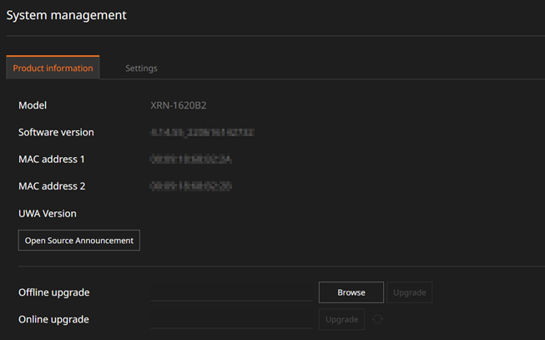
2-2. How to reset
1
Upgrade
Case 1
Case 2
Case 3
Case 4
Upgrade NVR to the latest version.
Upgrade the Wisenet Mobile application to the latest version.
- Check or .
PARTNER

Slide 9
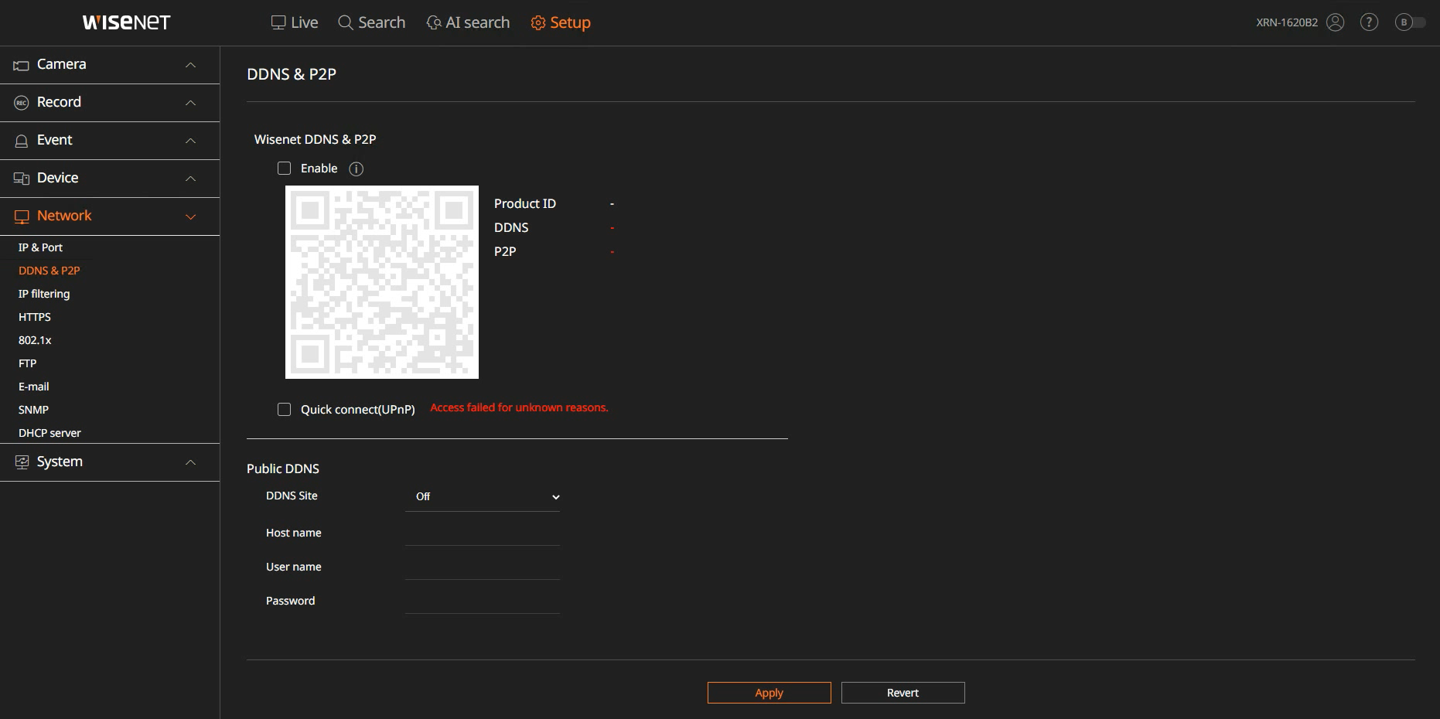
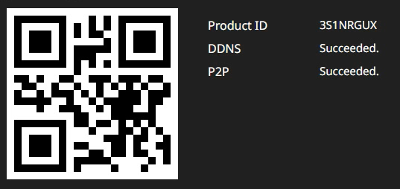
2-2. How to reset
Activate DDNS/P2P
2
Case 1
Case 2
Case 3
Case 4
In the [Setup] > [Network] > [DDNS&P2P] menu of the device, select [Enable]. The QR code is activated.
1
2
PARTNER

Slide 10
2-2. How to reset
Check out a new DDNS ID
3
Case 1
Case 2
Case 3
Case 4
[Setup] > [Network] > [DDNS&P2P]
http://ddns.hanwha-security.com/<Product ID>
You can always check your <Product ID> in the DDNS/P2P menu.
Connection address example: http://ddns.hanwha-security.com/3S1NRGUX
New QR code for
P2P registration
PARTNER

Slide 11
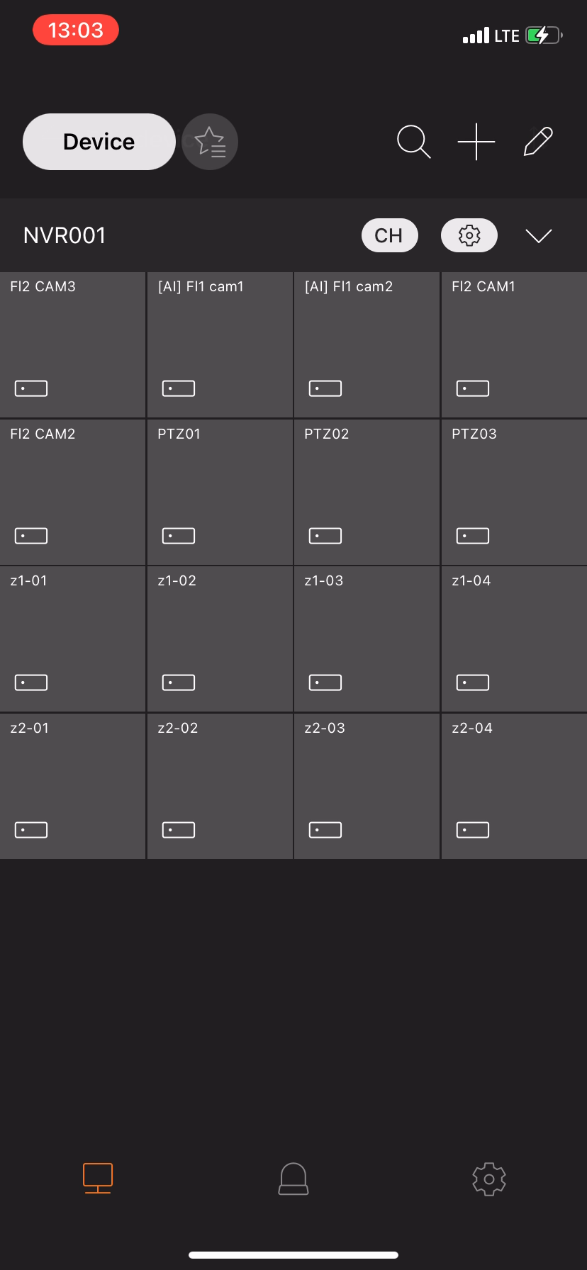
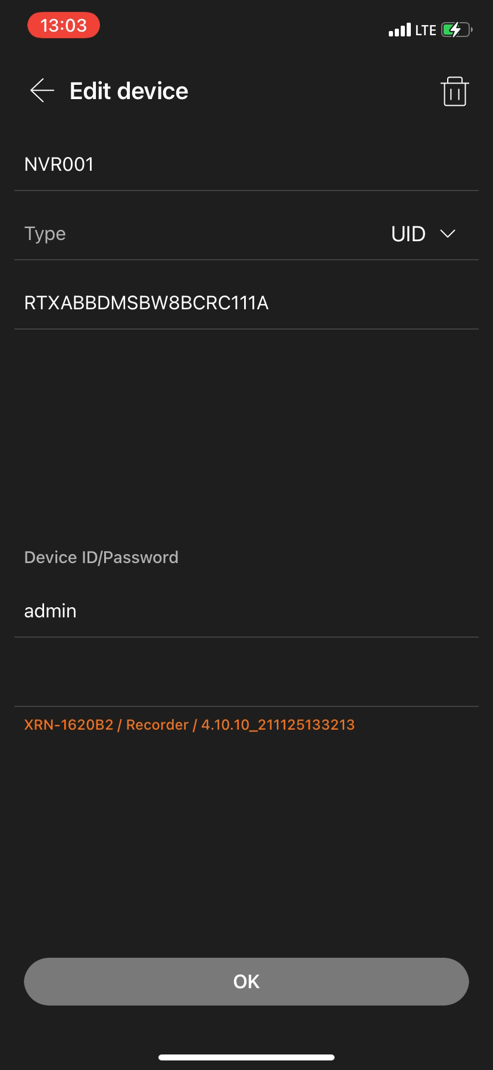
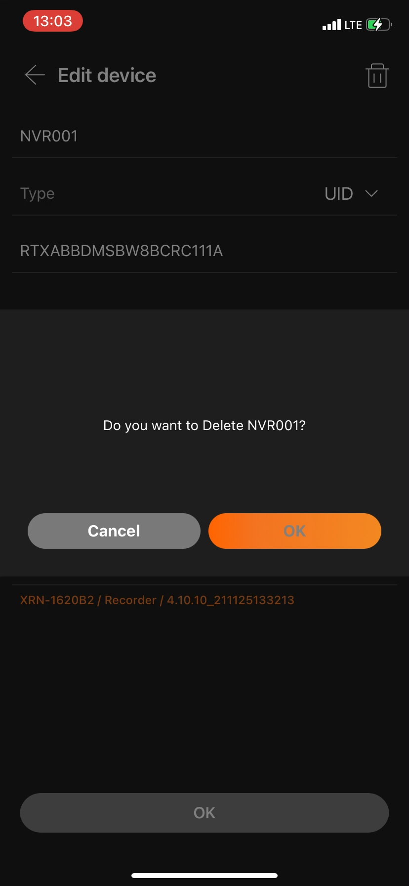
2-2. How to reset
4
Remove a device from the Wisenet Mobile app
Case 1
Case 2
Case 3
Case 4
Launch Wisenet Mobile to remove NVR from the device list.
- Remove only NVR to register as a new QR code from the list. (Devices where the current QR code is maintained are not to be deleted.)
- Refer to the list of the target models in page 3.
1
3
2
4
PARTNER

Slide 12
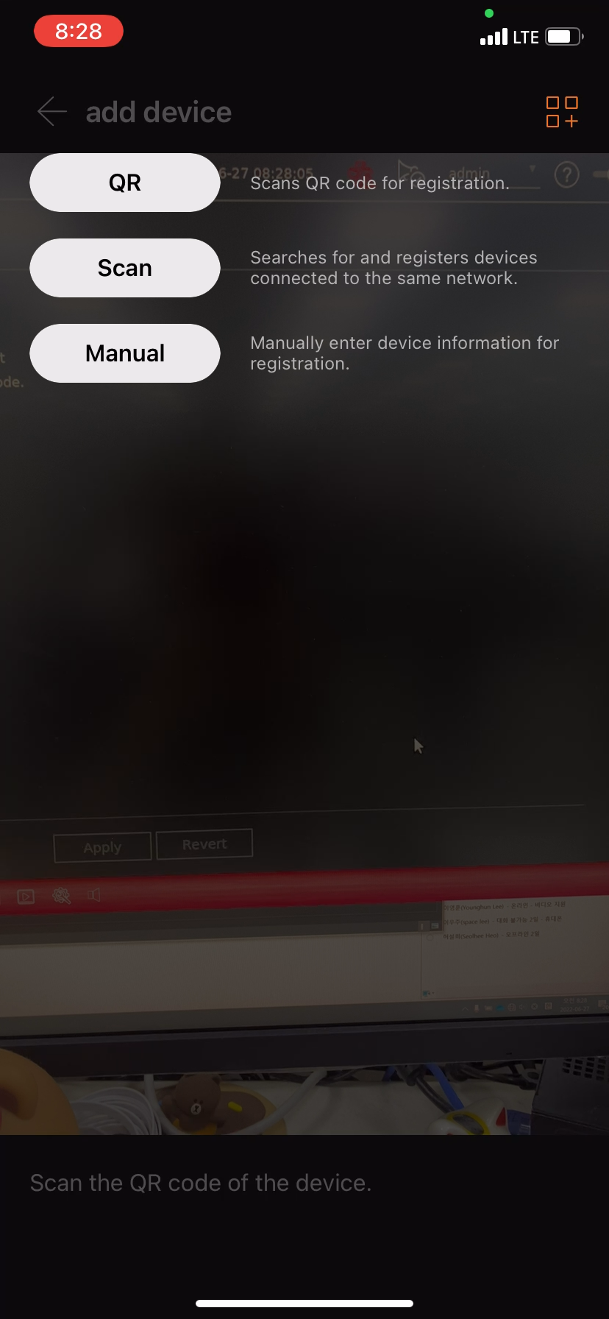
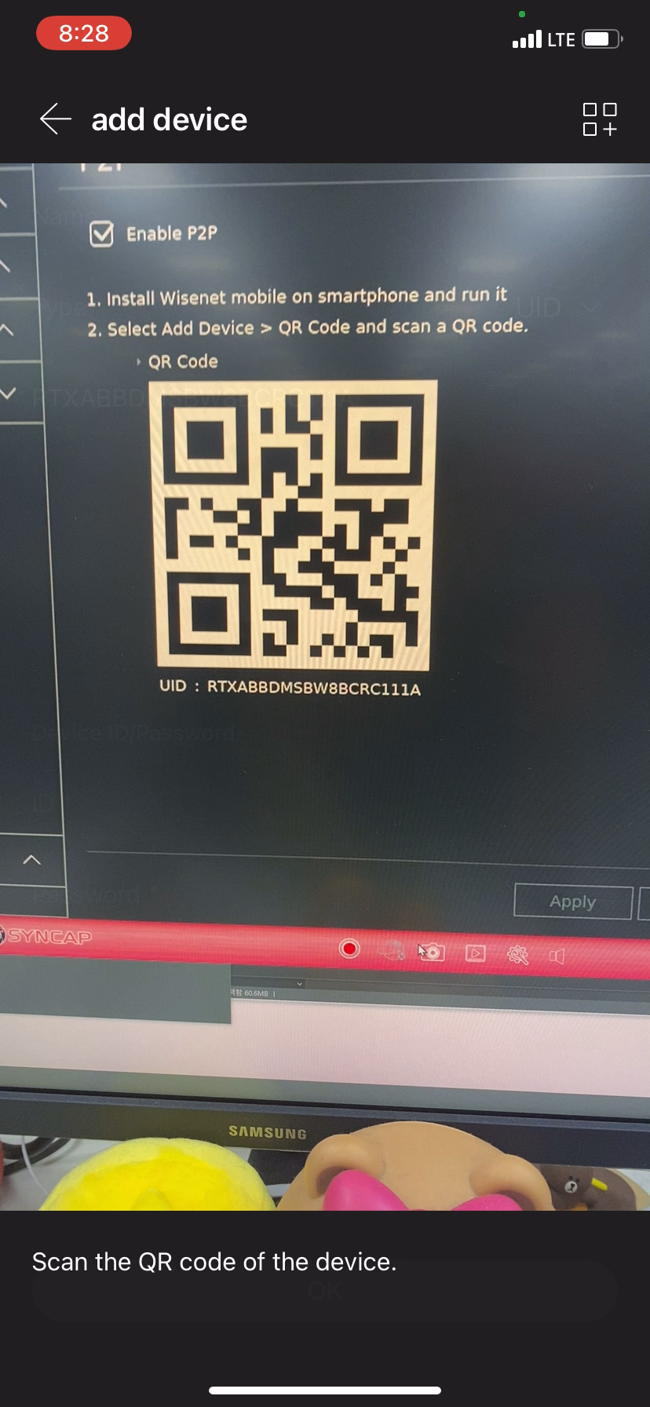
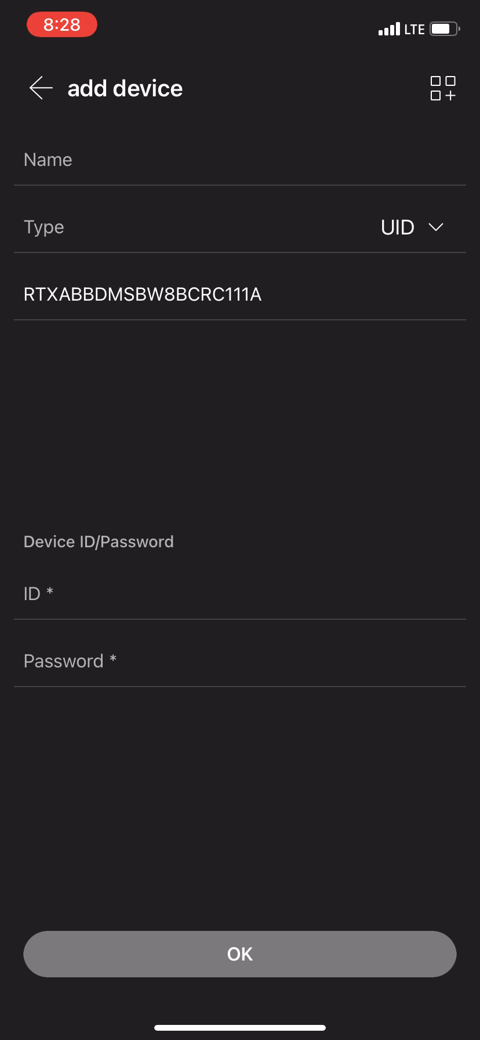
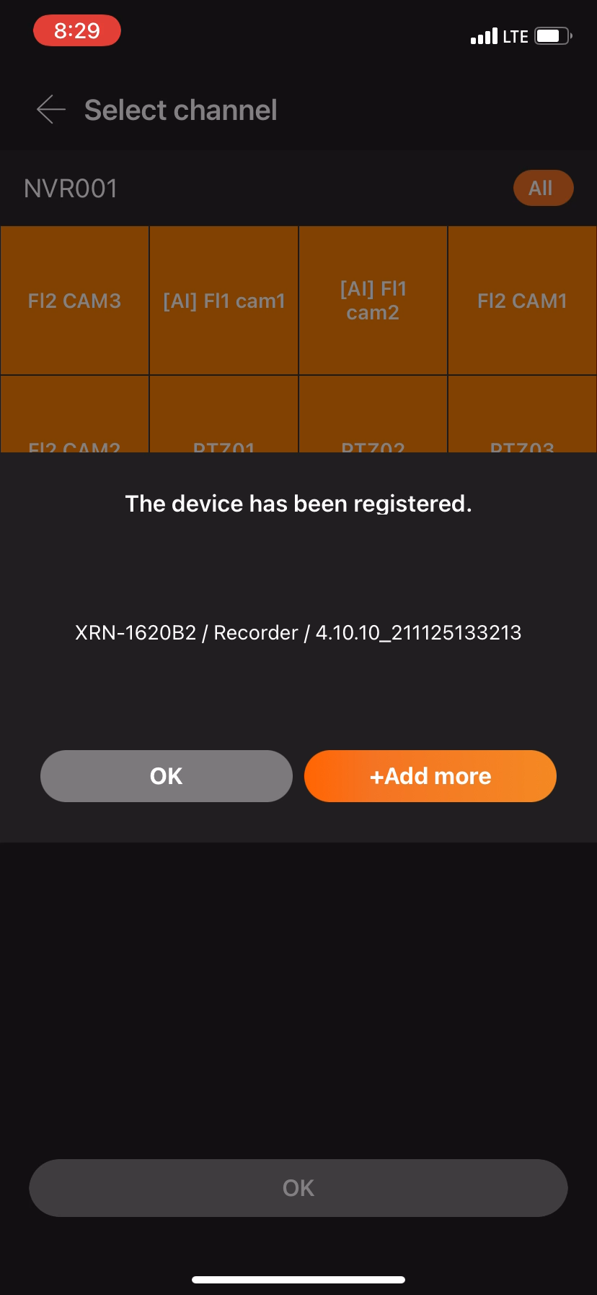
2-2. How to reset
5
Re-register a new QR code
Case 1
Case 2
Case 3
Case 4
Re-register a device using a new QR code in the Wisenet Mobile app.
1
2
Scan a new QR code
3
Enter the NVR administrator account information
PARTNER

Slide 13
2-3. Q & A
Q&A
Q) Can I still use the P2P function if I do not reset the P2P after the upgrade?
A) No, you cannot. You must reset and re-register P2P in order to use it.
Q) Can I still use the DDNS function if I do not reset DDNS after the upgrade?
A) If you’ve ever registered DDNS before, you can use it with the previous DDNS address.
However, the previously registered ID information cannot be checked in NVR. For this reason, those who
do not have the information available are recommended to re-register a new ID.
Q) Do I have to reset P2P/DDNS every time I conduct a software upgrade?
A) No, it is only required once.
PARTNER

Slide 14
2-3. Q & A
Q&A
Q) If I have to conduct a software downgrade while a problem occurs, can I still use the P2P function?
A) You can use it, but you need to reset the P2P function once again.
However, we do not recommend downgrades due to system stability.
Q) If I have to conduct a software downgrade while a problem occurs, can I still use the DDNS function?
A) If you’ve ever registered DDNS before an upgrade, you can use it with that ID.
If you have never registered DDNS before the upgrade, you need to create an ID in the DDNS site and
apply a newly created ID in NVR.
A) IDs that are automatically created in NVR cannot be used after downgrades. For this reason, if you have
a viewer or a third-party system that has been registered using the ID, it will have to be re-registered for
use. However, we do not recommend downgrades due to system stability.
PARTNER

Slide 15
6, Pangyo-ro 319beon-gil, Bundang-gu, Seongnam-si, Gyeonggi-do, Republic of Korea
www.hanwha-security.com

